Slide 1
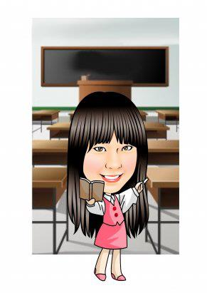
Hello!
My name is ________.
Mandy

Slide 2
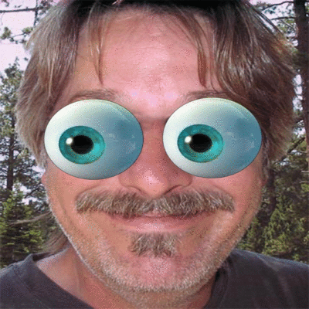
默契口號練習!
Teacher Mandy: One, two, three.
Eyes on me.
Students: One, two.
Eyes on you!

Slide 3
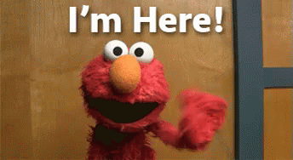
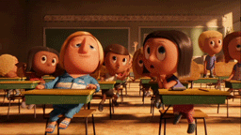
Let’s make a roll call!

Slide 5
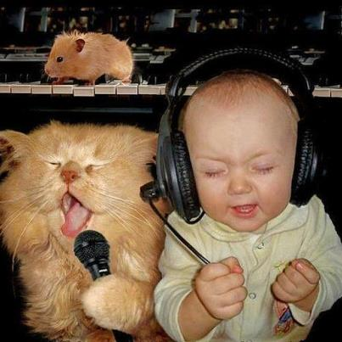
Hello Song
Hello! Hello!
Hello! What’s your name?
Hello! Hello! Hello~~~
My name is _______.
My name is _______.
Hello _____, hello _____, hello~~~

Slide 6
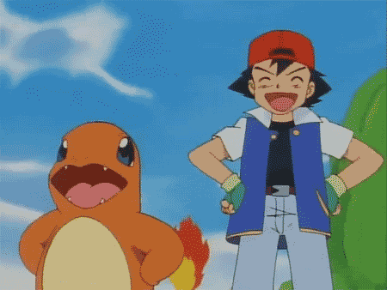
Let’s be a great and powerful learner.

Slide 8
How to do?
每週Tr. Mandy會出聆聽CD&跟讀的作業，若回家有完成，請家長(不限父母)協助在認證表上簽名。
以天數記，假如小朋友這週有3天聆聽&跟讀CD，就請家長在3顆寶貝球上簽名。
老師會每個月依據完成度在班上進行Happy Hour抽獎活動。
如果已將課本內容練習得很熟，想自己聆聽其他較難的內容(如:補習班教材/英語有聲書/英語卡通/廣播/YouTube…等)也可以!
若在家有聆聽CD或背單字，只是忘記將課本帶回家，還是可以再請家長補簽名認證的!不過只限當月份喔!

Slide 9
Who’s a good boy/girl?

Slide 18
Classroom English

Slide 19
Stand up.

Slide 20
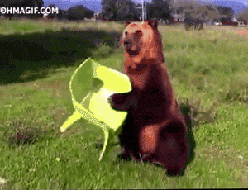
Sit down.

Slide 21
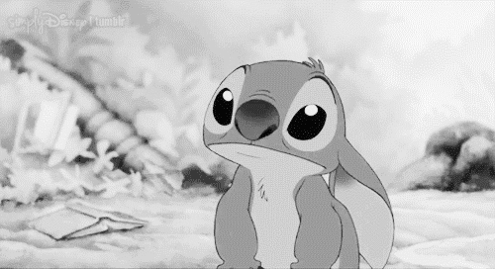
Listen!

Slide 22
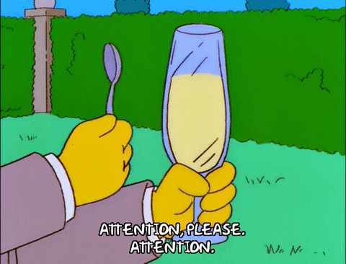
Attention!

Slide 23
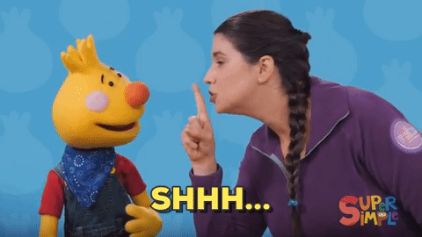
Quiet, please.

Slide 24
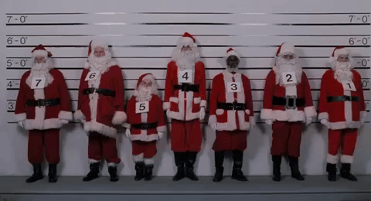
Line up.

